Slide 1

INT395
CA-1
Predictive Maintenance Scheduling
Tarun Teja
Umesh Chandra
Manish B

Slide 2
Outline
1. Background
2. Problem Statement
3. Dataset
4. Methodology
5. Models
6. Results
7. Caveats & Limitations
8. Conclusion
9. Acknowledgements
10. References

Slide 3
Background
1. Hospitals rely on medical devices, and unexpected failures can disrupt patient care and increase costs.
2. Traditional maintenance is mostly schedule-based and doesn’t use data to anticipate failures.
3. Device usage, age, downtime, and past failures contain patterns that can help predict risk.
4. Using machine learning to classify maintenance needs can make hospital operations safer and more efficient.

Slide 4
Problem Statement
1. Predict the maintenance risk level of medical devices based on their operational and maintenance history.
2. Classify each device into a maintenance class so hospitals can prioritize which devices need attention first.
3. Build a model that uses device features (age, downtime, failures, cost, etc.) to accurately identify high-risk equipment.
4. Enable proactive maintenance decisions instead of reacting to unexpected device failures.

Slide 5
Dataset
Source of the dataset: Kaggle
Features involved: Device type, age, manufacturer, model, country, maintenance cost, downtime, maintenance frequency, failure event count, and maintenance report text.
Size of dataset: 5,000 rows and 20 columns.
Preprocessing done: Handled categorical encoding, scaled numerical features, checked for missing values, and cleaned text fields.
Any challenges with the data: Mixed data types, noisy free-text maintenance reports, and risk of model overfitting due to limited data.

Slide 6
Methodology
Load dataset
Clean data
Encode categorical features
Scale numeric columns
Split into training and testing sets
Train multiple ML models
Compare performance metrics.

Slide 7
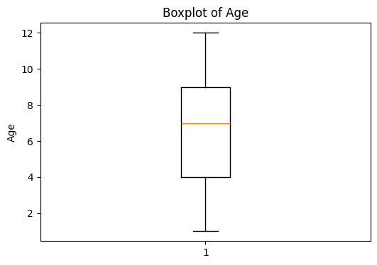
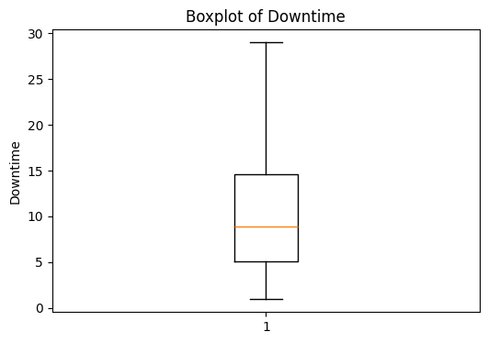
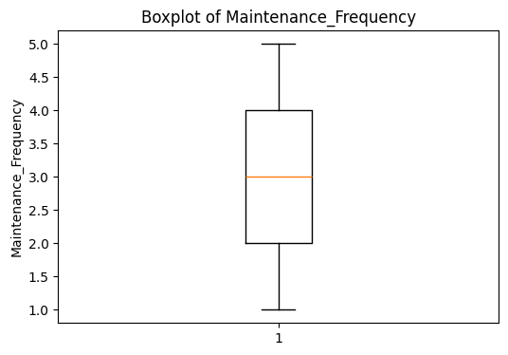
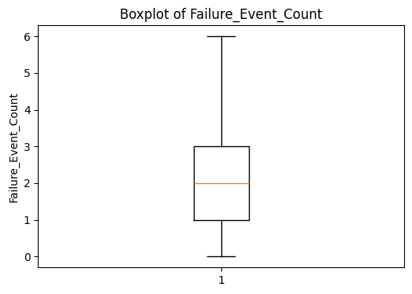

Slide 8
Methodology
Train–Test Split: Dataset split into training and testing sets to evaluate model generalization.
Feature Engineering: Label encoding for categorical fields, handling text fields, scaling/normalizing numerical features.
Algorithms Tried: Logistic Regression, KNN, Decision Tree, Random Forest, Gradient Boosting, XGBoost classifier, SVM.
Final Model Choice: XGBoost selected because it achieved the highest accuracy and consistently outperformed the other models.
Tools Used: Python, pandas, NumPy, scikit-learn, XGBoost, Matplotlib/Seaborn for visualization.

Slide 9
Model Explanation
1. We tested seven models: Logistic Regression, KNN, Decision Tree, Random Forest, Gradient Boosting, XGBoost, and SVM.
2. Each model learned from device features like age, downtime, cost, and past failure events.
3. Our best-performing model was Logistic Regression, which builds many small decision trees and improves them step by step.
4. Logistic Regression captured the patterns in the data most effectively, giving the highest accuracy among all models.

Slide 10
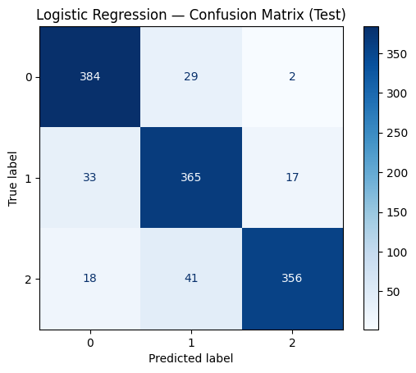

Slide 11
Results
 | Model | Train_acc | Test_acc
1 | Logistic Regression | 0.906598 | 0.887952
2 | KNN | 0.758361 | 0.657831
3 | Decision Tree | 0.934318 | 0.784337
4 | Random Forest | 0.960832 | 0.842169
5 | Gradient Boosting | 0.936427 | 0.885542
6 | XGBoost Classifier | 1.000000 | 0.892771
7 | SVM | 0.976198 | 0.861446

Slide 12
Results
Model Performance: Logistic Regression achieved the highest accuracy (≈90%), outperforming Logistic Regression, Random Forest, SVM, and others.
Metrics:
Confusion Matrix: Shows almost perfect classification with minimal mislabels, confirming the model’s reliability on this dataset.
Graphs: ROC curves are near the top-left corner, and model comparison plots show XGBoost leading all other algorithms.
Interpretation: The features—device age, downtime, maintenance cost, and failure history—carry strong predictive power.
The final model can accurately classify device maintenance risk and supports proactive maintenance planning.

Slide 13
Caveats & Limitations
1. Dataset is from Kaggle, so it may not fully represent real hospital conditions.
2. Text fields (maintenance reports) contain noise and weren’t deeply processed.
3. Model may not generalize well to different manufacturers, hospitals, or real-world device usage patterns.
4. Predictions support decision-making but do not replace expert technician judgment.

Slide 14
Conclusion
1. We built a machine learning model that predicts maintenance needs for medical devices.
2. The results show strong predictive power, helping reduce unexpected failures and downtime.
3. This approach supports better technician scheduling and improves overall patient safety.
4. The project demonstrates how data-driven maintenance can make hospital operations more efficient.

Slide 15
Acknowledgements
Instructor for guidance throughout the project
Team members for collaboration and support
Dataset source: Kaggle medical device maintenance dataset
Anyone who provided feedback or technical help during development

Slide 16
References
https://ieeexplore.ieee.org/document/6648845
https://www.sciexplor.com/articles/bmeh.2024.135
https://www.researchgate.net/publication/384638324_Strategies_For_Optimizing_The_Management_Of_Medical_Equipment_In_Large_Healthcare_Institutions
https://www.sciencedirect.com/search?qs=predictive maintenance medical equipment
https://ieeexplore.ieee.org/document/10233874
https://www.researchgate.net/publication/391526112_Predictive_Maintenance_Using_Machine_Learning_Techniques_and_Applications
https://www.researchgate.net/publication/339627406_Space_mining_is_the_industry_of_the_future_or_maybe_the_present
https://www.who.int/teams/health-product-policy-and-standards/assistive-and-medical-technology/medical-devices/policies
https://www.geeksforgeeks.org/machine-learning/understanding-logistic-regression/
https://www.geeksforgeeks.org/software-engineering/what-is-preventive-maintenance-pm-a-complete-guide/
https://www.researchgate.net/publication/339627406_Space_mining_is_the_industry_of_the_future_or_maybe_the_present
https://www.sciencedirect.com/science/article/pii/S2543106425000201

